Slide 1
DDoS Attack and Detection system using Artificial Neural Networks
Submitted by
Vishwath Kumar B S (Reg.No. : 18BEC1289)
Yogeeshwar S (Reg.No. : 18BEC1343)
Ram S Kaushik (Reg.No. : 18BEC1024)
Under the Guidance of
Dr. P. Vijayakumar
Associate Professor

Slide 2
Content
Objective of the Project
Introduction
Related Works
Proposed Botnet DDoS Attack and Detection system using DL
Software Details
Summary
References

Slide 3
Objective of the Project
To perform DDoS attack with the help of Botnet (zombies).
To implement the different DL algorithms to detect DDoS attacks.
Finally, compare the performance of different DL algorithms by using accuracy, confusion matrix etc.,

Slide 4
Introduction
NEED FOR DDoS DETECTION SYSTEM.
DDoS is a very powerful attack and it can range from attacking an individual to attacking top organizations to steal information and exploit them.
So, to prevent this attack from endangering many companies a detection system is very essential to protect your valuable information.
FEW INCIDENTS INVOLVING DDoS ATTACK:
1) The AWS DDoS Attack in 2020:
Amazon Web Services, the 800-pound gorilla of everything cloud computing, was hit by a gigantic DDoS attack in February 2020.
This was the most extreme recent DDoS attack ever and it targeted an unidentified AWS customer using a technique called Connectionless Lightweight Directory Access Protocol (CLDAP) Reflection.
This technique relies on vulnerable third-party CLDAP servers and amplifies the amount of data sent to the victim’s IP address by 56 to 70 times. The attack lasted for three days and peaked at an astounding 2.3 terabytes per second.

Slide 5
Introduction
2) The Mirai Krebs and OVH DDoS Attacks in 2016:
On September 20, 2016, the blog of cybersecurity expert Brian Krebs was assaulted by a DDoS attack in excess of 620 Gbps, which at the time, was the largest attack ever seen.
Krebs’ site had been attacked before. Krebs had recorded 269 DDoS attacks since July 2012, but this attack was almost three times bigger than anything his site or, for that matter, the internet had seen before.
The source of the attack was the Mirai botnet, which, at its peak later that year, consisted of more than 600,000 compromised Internet of Things (IoT) devices such as IP cameras, home routers, and video players.
The Mirai botnet had been discovered in August that same year but the attack on Krebs’ blog was its first big outing.
Machine learning is used to detect DDoS attack

Slide 6
Machine Learning
Machine learning is an application of artificial intelligence (AI) that provides systems the ability to automatically learn and improve from experience without being explicitly programmed.
Machine learning focuses on the development of computer programs that can access data and use it learn for themselves.
The process of learning begins with observations or data, such as examples, direct experience, or instruction, in order to look for patterns in data and make better decisions in the future based on the examples that we provide.
The primary aim is to allow the computers learn automatically without human intervention or assistance and adjust actions accordingly.

Slide 7
Related Works
Debajyoti Mukhopadhyay [1] proposed a paper on A Study on Recent Approaches in Handling DDoS Attacks.
Khalid A. Fakeeh [2] proposed a paper on An Overview of DDOS Attacks Detection and Prevention in the Cloud.
Naveen Bindra [3] proposed a paper on Detecting DDoS Attacks Using Machine Learning Techniques and Contemporary Intrusion Detection Dataset and achieved an accuracy rate of 96%.

Slide 8
Proposed Botnet DDoS Attack and Detection System using ML
Botnet DDoS Attack and Detection System using ML
We use botnet(zombies) to perform a DDoS (Distributed Denial of Service) attack.
We are going to use legitimate hosts as zombies or bots and ping flood a victim to crash his server.
This slows down the performance of the system and will allow the attacker a backdoor entry to retrieve all the information about the victim.
But this attack is illegal and results in huge damage and loss of information.
So we also decided to come up with a DDoS attack detection system using Machine Learning.

Slide 9
Proposed Botnet DDoS Attack and Detection System using ML
We are planning to use two separate algorithms namely ANN(Artificial Neural Network) and BRNN(Bidirectional Neural Network)
Then we are going to compare the accuracy obtained from both the algorithms, and conclude the best suited algorithm for detection of botnet based DDoS attack.

Slide 10
Deep Learning algorithms
ARTIFICIAL NEURAL NETWORKS
The Artificial Neural Network receives information from the external world in the form of pattern and image in vector form. These inputs are mathematically designated by the notation x(n) for n number of inputs.
Each input is multiplied by its corresponding weights. Weights are the information used by the neural network to solve a problem. Typically weight represents the strength of the interconnection between neurons inside the Neural Network.
The weighted inputs are all summed up inside the computing unit (artificial neuron). In case the weighted sum is zero, bias is added to make the output not- zero or to scale up the system response. Bias has the weight and input always equal to ‘1′.
The sum corresponds to any numerical value ranging from 0 to infinity. To limit the response to arrive at the desired value, the threshold value is set up. For this, the sum is passed through an activation function.
The activation function is set to the transfer function used to get the desired output. There are linear as well as the nonlinear activation function.
Some of the commonly used activation function is – binary, sigmoidal (linear) and tan hyperbolic sigmoidal functions(nonlinear).

Slide 11
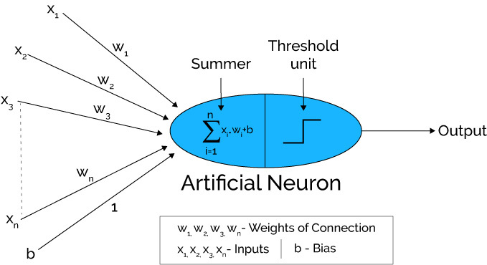
Deep Learning algorithms

Slide 12
Deep Learning algorithms
BIDIRECTIONAL NEURAL NETWORKS
Bidirectional Recurrent Neural Networks (BRNN) connect two hidden layers of opposite directions to the same output. With this form of generative deep learning, the output layer can get information from past (backwards) and future (forward) states simultaneously.
The principle of BRNN is to split the neurons of a regular RNN into two directions, one for positive time direction (forward states), and another for negative time direction (backward states). Those two states’ output are not connected to inputs of the opposite direction states. The general structure of RNN and BRNN can be depicted in the right diagram. By using two time directions, input information from the past and future of the current time frame can be used unlike standard RNN which requires the delays for including future information.

Slide 13
Deep Learning algorithms
BIDIRECTIONAL NEURAL NETWORKS
BRNNs can be trained using similar algorithms to RNNs, because the two directional neurons do not have any interactions. However, when back-propagation is applied, additional processes are needed because updating input and output layers cannot be done at once. General procedures for training are as follows: For forward pass, forward states and backward states are passed first, then output neurons are passed. For backward pass, output neurons are passed first, then forward states and backward states are passed next. After forward and backward passes are done, the weights are updated.

Slide 14
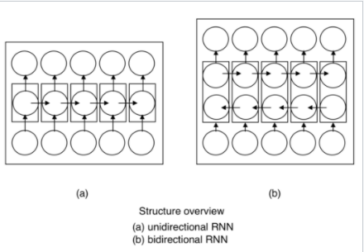
Deep Learning Algorithms

Slide 15
NOVELTY
Using BRNN to Detect the DDoS attacks will drastically increase the accuracy which is far better than current normal ML techniques.

Slide 16
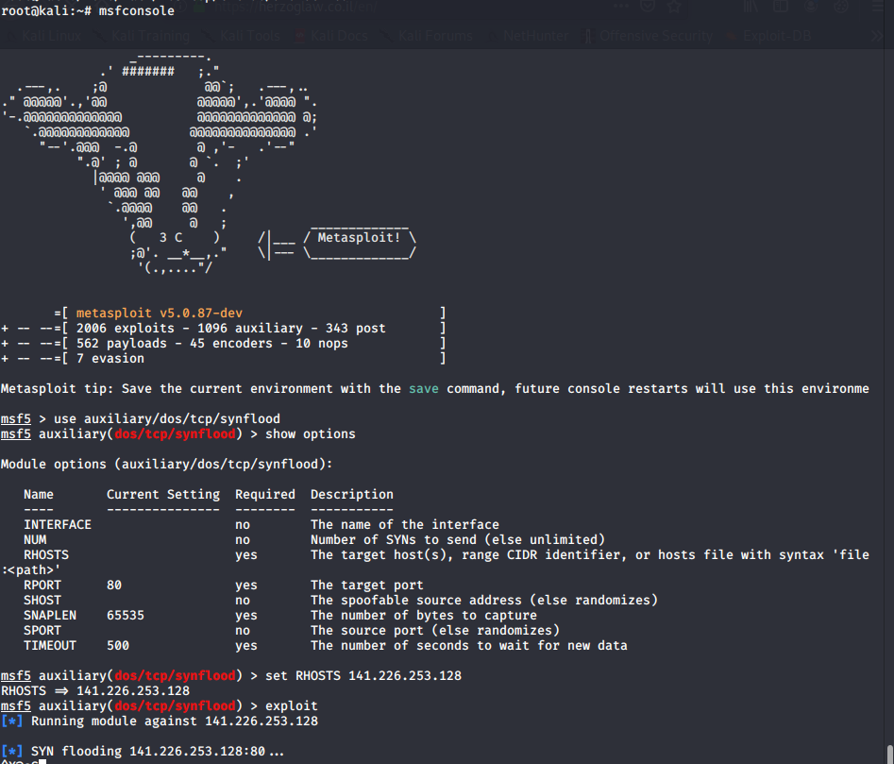
OUTPUT – DoS Attack

Slide 17
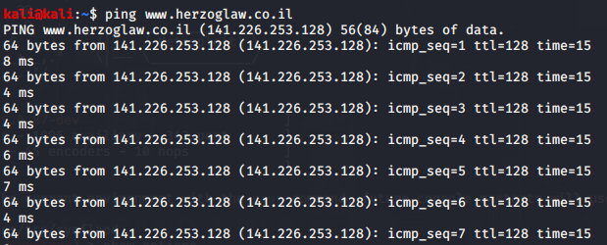
OUTPUT - DoS Attack

Slide 18

OUTPUT(BEFORE ATTACK)

Slide 19
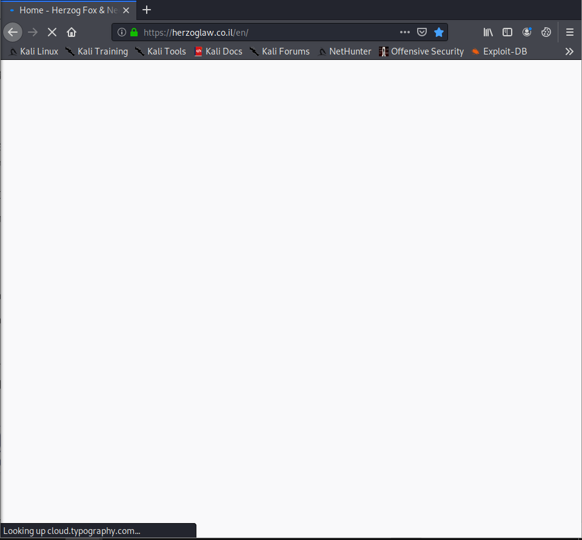
OUTPUT(AFTER ATTACK)

Slide 20
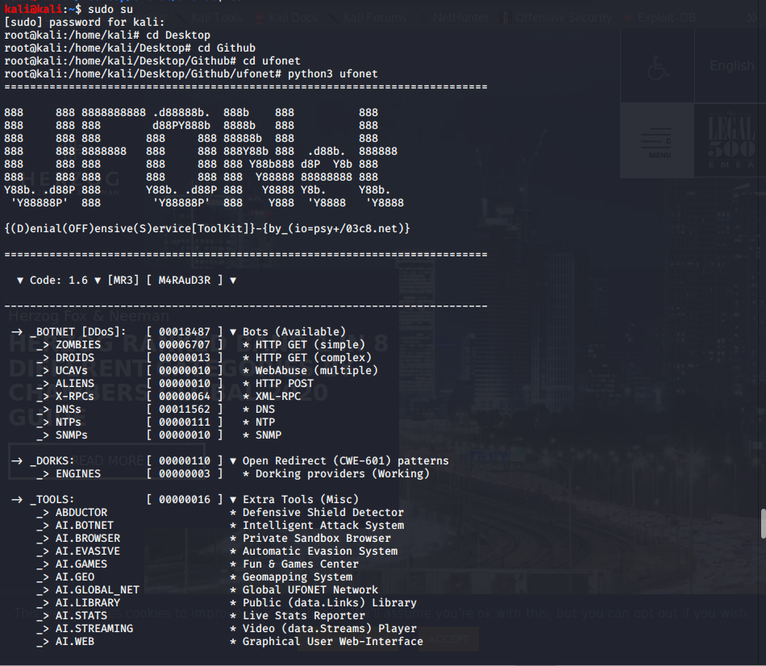
OUTPUT – DDoS Attack

Slide 21
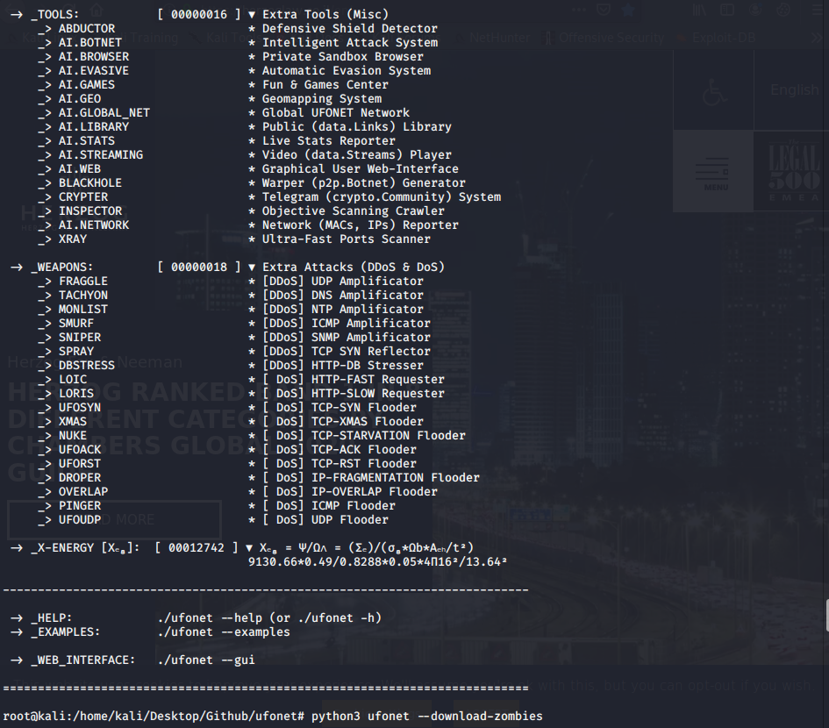
OUTPUT– DDoS Attack

Slide 22
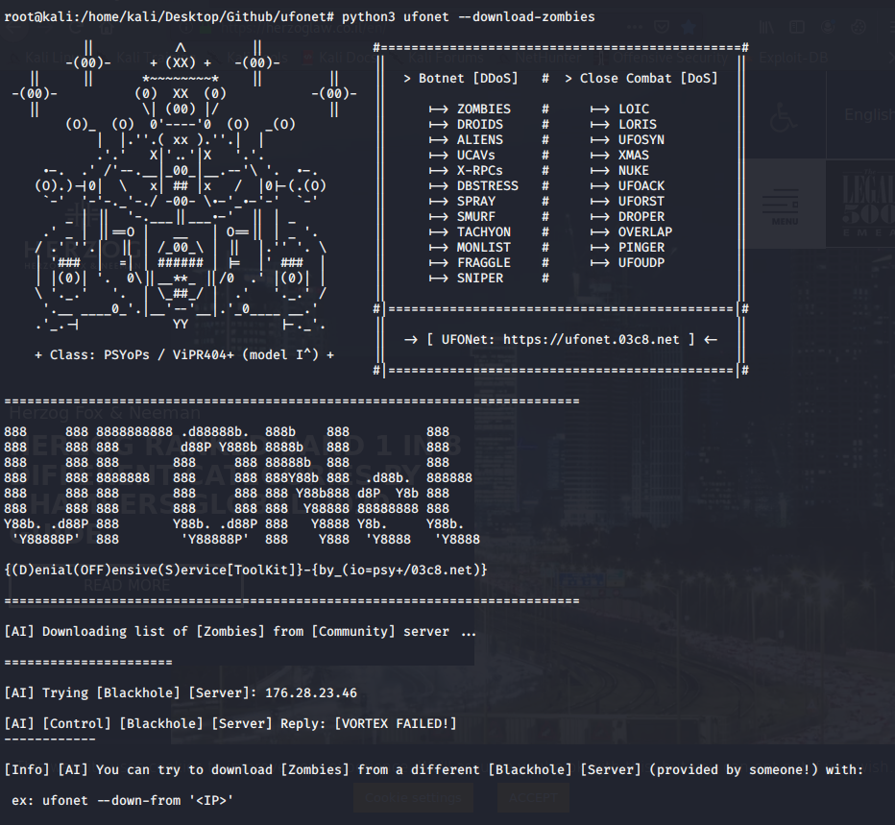
OUTPUT– DDoS Attack

Slide 23
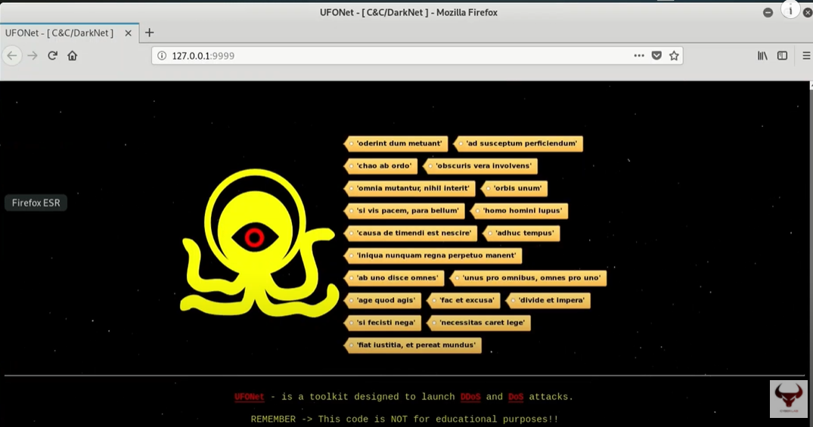
OUTPUT– DDoS Attack

Slide 24
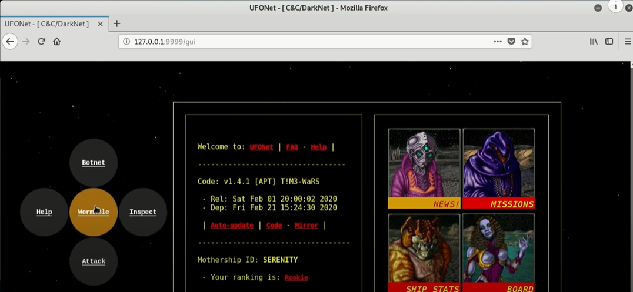
OUTPUT– DDoS Attack

Slide 25
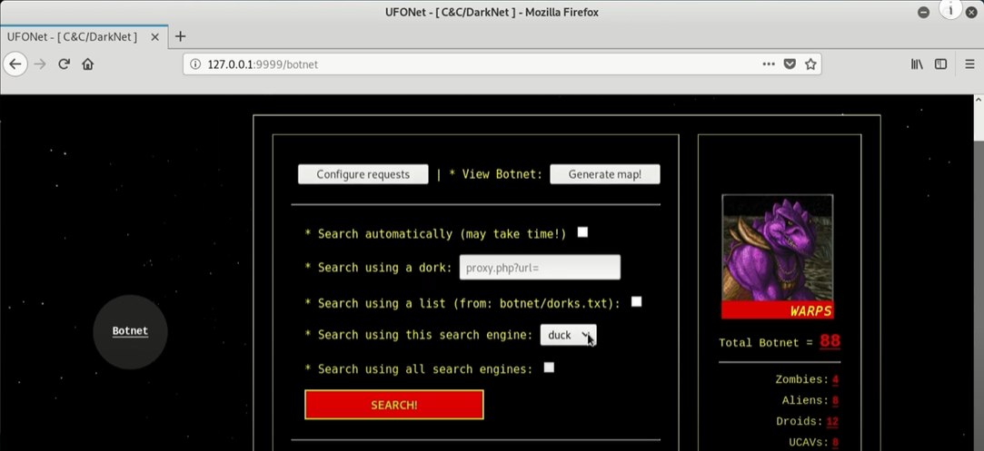
OUTPUT– DDoS Attack

Slide 26
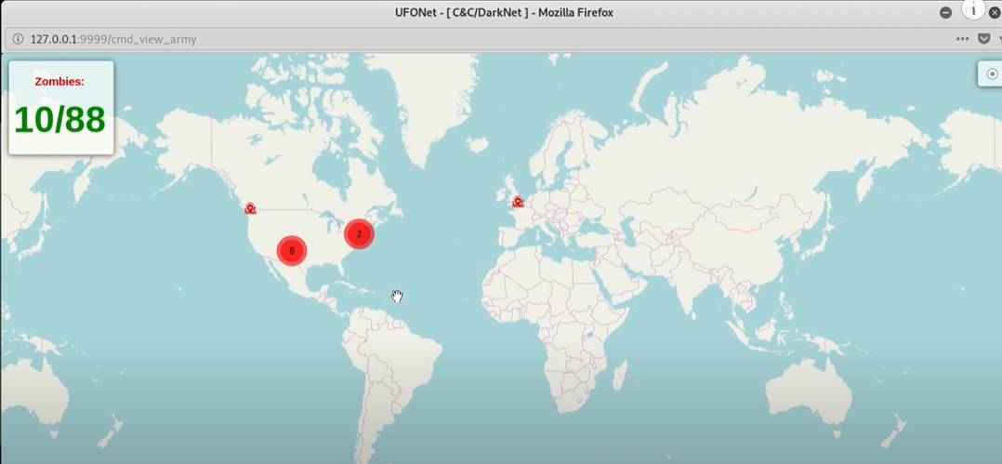
OUTPUT– DDoS Attack

Slide 27
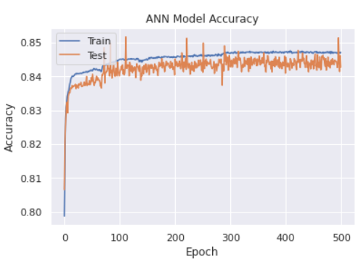
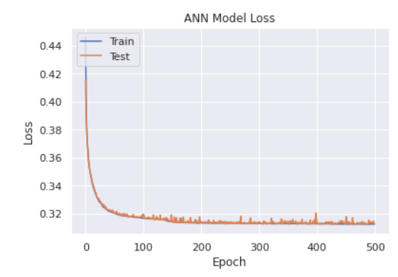
OUTPUT – Detection using ANN

Slide 28
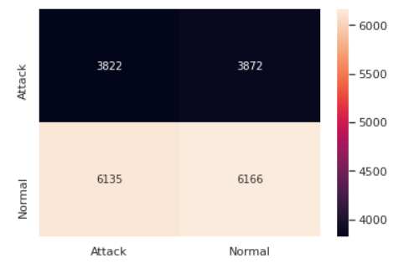
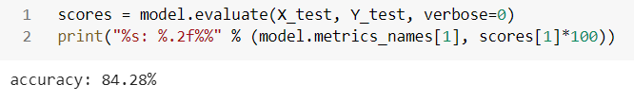
OUTPUT – Detection using ANN

Slide 29
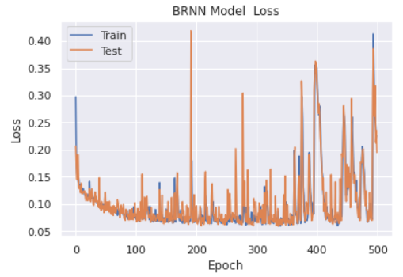
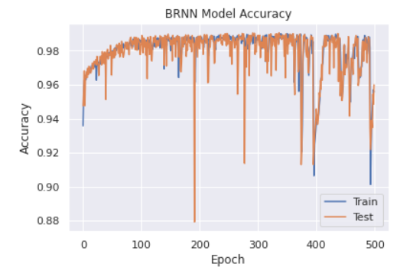
OUTPUT – Detection using BRNN

Slide 30
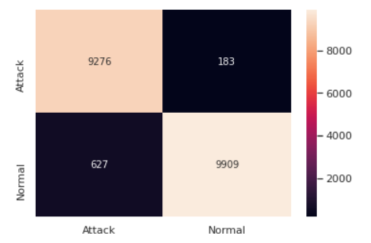
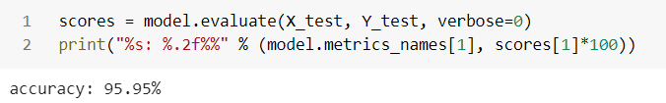
OUTPUT – Detection using BRNN

Slide 31
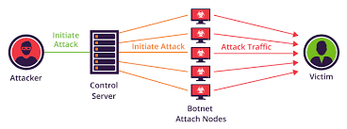
Block Diagram of DDoS Attack and Detection System using ML
Botnet DDoS Attack:

Slide 32
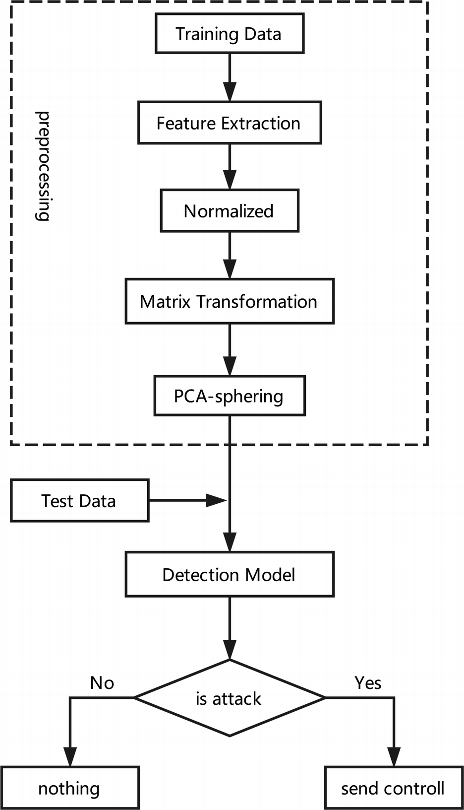
B
Detection of DDoS Attack using ML model:

Slide 33
Software Details
Jupyter Notebook:
The Jupyter Notebook is an open-source web application that allows you to create and share documents that contain live code, equations, visualizations and narrative text.
Kali Linux :
Kali Linux is a Debian-derived Linux distribution designed for digital forensics and penetration testing.

Slide 34
Summary
The proposed model uses multiple layered perceptron architecture and resilient backpropagation for its training and testing.
The developed system is then applied to denial of service attacks.
Moreover, the performance of these two neural networks is compared with similar testing conditions and have been found that bi-directional recurrent neural network (BRNN) has more accuracy (96%) than the traditional artificial neural network (ANN) (84%)..

Slide 35
Reference
[1] Naveen Bindra, Manu Sood Detecting DDoS Attacks Using Machine Learning Techniques and Contemporary Intrusion Detection Dataset. Aut. Control Comp. Sci. 53, 419–428 (2019).
[2] DDoS Attacks Detection Using Machine Learning Algorithms
Digital TV and Multimedia Communication, 2019, Volume 1009
ISBN : 978-981-13-8137-9;Qian Li, Linhai Meng, Yuan Zhang
[3] Kumar, S., Azad, M., Gomez, O., et al.: Can Microsoft?s Service Pack2 (SP2) security software prevent SMURF attacks?. In: Advanced International Conference on Telecommunications and International Conference on Internet and Web Applications and Services, p. 89. IEEE (2006)

Slide 36
Reference
[4] Kumar, S., Azad, M., Gomez, O., et al.: Can Microsoft?s Service Pack2 (SP2) security software prevent SMURF attacks?. In: Advanced International Conference on Telecommunications and International Conference on Internet and Web Applications and Services, p. 89. IEEE (2006)
[5] Dong, P., Du, X., Zhang, H., et al.: A detection method for a novel DDoS attack against SDN controllers by vast new low-traffic flows. In: IEEE International Conference on Communications, pp. 1–6. IEEE (2016)
[6] Mousavi, S.M., Sthilaire, M.: Early detection of DDoS attacks against SDN controllers. In: International Conference on Computing, Networking and Communications, pp. 77–81. IEEE (2015)

